Slide 1
IT Ticket Analysis
-Vaishnav Nilay Dinesh

Slide 2
Problem Statement
Analyze the IT support ticket system to assess agent performance, ticket resolution efficiency, and employee satisfaction. Identify top and low performers, evaluate team effectiveness, and recommend staffing actions (hiring, firing, training) to improve service quality.

Slide 3
Data Overview
Dataset allows for an in-depth analysis of tickets’ satisfaction rating and resolution time and also allows to draw insights about the top and low performing agents.
Dataset include:
Total number of tickets: 97498
Total number of employees who are raising tickets: 2000
Total number of agents who are resolving tickets: 50
Other data: type of ticket, satisfaction rating, resolution time etc.

Slide 4
Agenda
Count Of Tickets Over the Years
Category Wise Count Of Tickets
Age Wise Satisfaction Rate
Average Resolution Time Vs Average Satisfaction Rate
Issue Type Wise Resolution Time and Satisfaction Rate
Tickets By Severity Rate
Count Of Tickets vs Resolution Time
Count Of Tickets By Priority
Category Wise Resolution Time and Satisfaction Rate
Dashboard
Recommendations

Slide 5
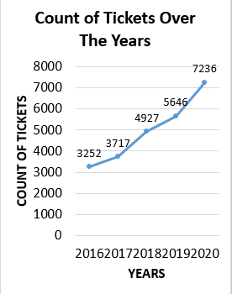
Year Wise Count Of Tickets with Satisfaction Rating
As Per the Analysis, The Count of Tickets has been increased from 2016 to 2020.

Slide 6
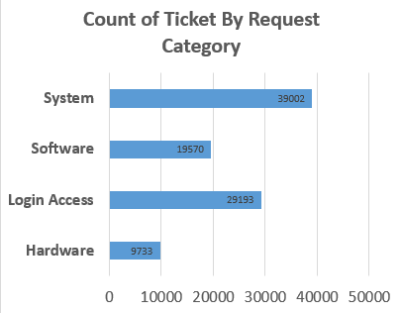
Category Wise Count Of Tickets
As per the chart, out of these categories, System has maximum 39002 number of requests as compared to other categories.

Slide 7
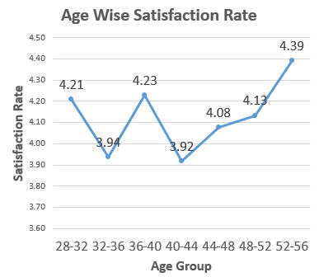
Age Wise Satisfaction Rate
As per the Analysis, Age Group of 52-56 has higher satisfaction rate. This can be because of less number of tickets are handled by this age category as compared to all other age categories.

Slide 8
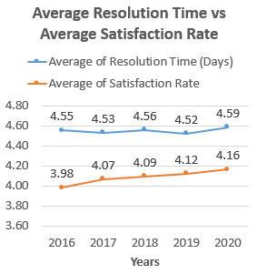
Year Wise Average Resolution Time and Average Satisfaction Rating
As per the chart, The Average Resolution Time over the years is bit increased but with that Average Satisfaction Rate is also increased.

Slide 9
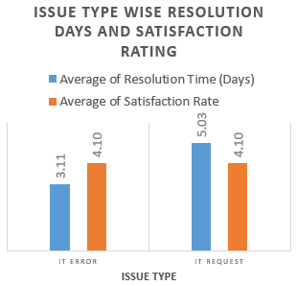
Issue Type Wise Resolution Time and Satisfaction Rating
As per the Analysis, Satisfaction Rate is same among both issue types but Resolution time of IT Request is higher because higher number of tickets are in IT Request type.

Slide 10
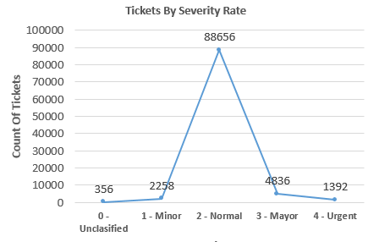
Tickets By Severity Rate
Majority of Tickets lies in the Normal Severity Rate whereas the count of tickets in the urgent severity is only 1392.

Slide 11
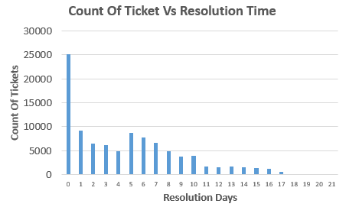
Count Of Tickets Vs Resolution Time
Highest Number around 25000 tickets were resolved on the same day on which it was assigned to the agents.

Slide 12
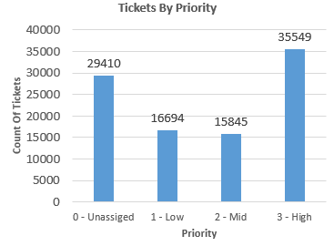
Count Of Tickets By Priority
Highest count of tickets were raised in the high priority which is 35549.

Slide 13
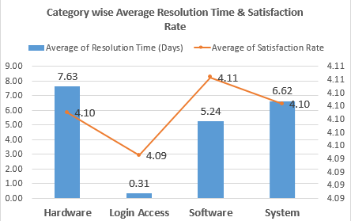
Category Wise Resolution Time And Satisfaction Rate
The Average Resolution Time was highest in the category of Hardware and lowest in Login Access.
The Average Satisfaction Rate was highest in Software category and lowest in Login Access.

Slide 14
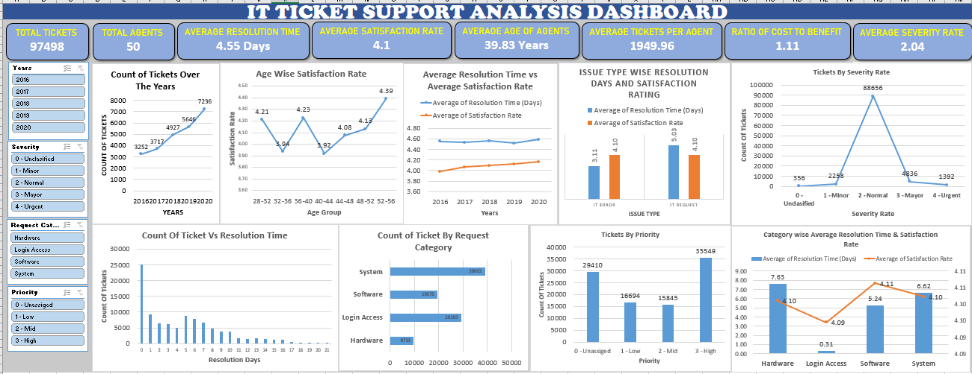
Dashboard

Slide 15
Recommendations
The Average Resolution Time is 4.55, specially it’s higher for system and software category, it should be reduced.
The count of High Severity Tickets should be prioritized to avoid negative impact.
The satisfaction rate in the age category of 32-36 is low so it should be improved by providing more personalized support or targeted trainings.
Average agent Ticket count is 1949.96 so we should ensure agents are not overloaded as this can reduce their performance so we should hire more number of agents.
Categories such as System and Software have High Ticket volumes so we should allocate specialized teams to handle these requests.
As Average Age of agent is 39.83 so we should ensure continuous training programs to keep agents updated on modern tools, softwares and techniques to improve their Efficiency.

Slide 16
Conclusion
The average resolution time of 4.55 days is higher than optimal. Automation, Repetitive tasks and enhancing resource allocation can reduce resolution time.
Satisfaction Rate is steady but need targeted attention as their is disparities among age groups and issue, categories.
There is higher volume of tickets per agent which lead to more workload and reduce efficiency so need to hire more agents.
High Priority and Severity Tickets should be prioritized.

Slide 17
Thank You!

